Slide 1
Take a Close Look at
MapReduce
Xuanhua Shi

Slide 2
Acknowledgement
Most of the slides are from Dr. Bing Chen, http://grid.hust.edu.cn/chengbin/
Some slides are from SHADI IBRAHIM, http://grid.hust.edu.cn/shadi/

Slide 3
What is MapReduce
Origin from Google, [OSDI’04]
A simple programming model
Functional model
For large-scale data processing
  Exploits large set of commodity computers
  Executes process in distributed manner
  Offers high availability

Slide 4
Motivation
Lots of demands for very large scale data processing
A certain common themes for these demands
  Lots of machines needed (scaling)
  Two basic operations on the input
    Map
    Reduce

Slide 5
Distributed Grep
Split data
grep
matches
Split data
grep
matches
Very
big
data
All
matches
Split data
grep
matches
cat
Split data
grep
matches

Slide 6
Distributed Word Count
Split data
count
count
Split data
count
count
Very
big
data
merged
count
Split data
count
count
merge
Split data
count
count

Slide 7
Map+Reduce
Map:
  Accepts input key/value pair
  Emits intermediate key/value pair
R
E
D
U
C
E
Reduce :
  Accepts intermediate key/value* pair
  Emits output key/value pair
Very
big
data
M
A
P
Partitioning
Function
Result

Slide 8
The design and how it works

Slide 9

Architecture overview
Master node
user
Job tracker
Slave node 1
Slave node 2
Slave node N
Task tracker
Task tracker
Task tracker
Workers
Workers
Workers

Slide 10
GFS: underlying storage system
Goal
  global view
  make huge files available in the face of node failures
Master Node (meta server)
  Centralized, index all chunks on data servers
Chunk server (data server)
  File is split into contiguous chunks, typically 16-64MB.
  Each chunk replicated (usually 2x or 3x).
    Try to keep replicas in different racks.

Slide 11
GFS architecture
GFS Master
Client
C₀
C₁
C₁
C₀
C₅
…
C₅
Chunkserver 1
Chunkserver 2
Chunkserver N
C₂
C₅
C₃
C₂

Slide 12
Functions in the Model
Map
  Process a key/value pair to generate intermediate key/value pairs
Reduce
  Merge all intermediate values associated with the same key
Partition
  By default : hash(key) mod R
  Well balanced

Slide 13
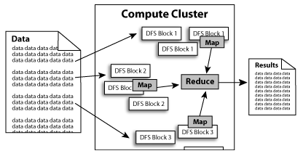
Diagram (1)

Slide 14
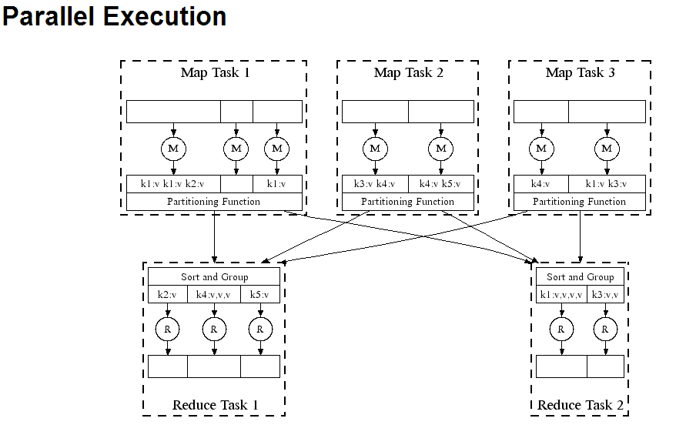
Diagram (2)

Slide 15
A Simple Example
Counting words in a large set of documents
map(string value)‏
  //key: document name
  //value: document contents
  for each word w in value
    EmitIntermediate(w, “1”);
reduce(string key, iterator values)‏
  //key: word
  //values: list of counts
  int results = 0;
  for each v in values
    result += ParseInt(v);
  Emit(AsString(result));

Slide 16
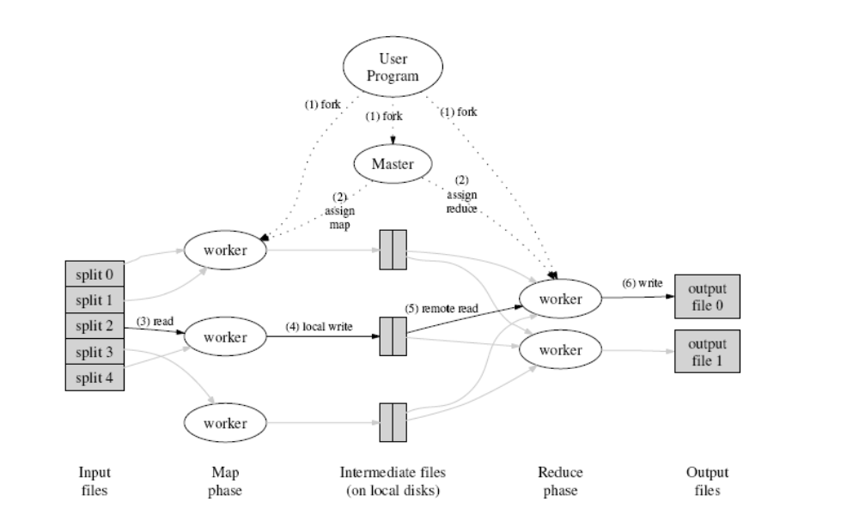
How does it work?

Slide 17
Locality issue
Master scheduling policy
  Asks GFS for locations of replicas of input file blocks
  Map tasks typically split into 64MB (== GFS block size)
  Map tasks scheduled so GFS input block replica are on same machine or same rack
Effect
  Thousands of machines read input at local disk speed
  Without this, rack switches limit read rate

Slide 18
Fault Tolerance
Reactive way
  Worker failure
    Heartbeat, Workers are periodically pinged by master
      NO response = failed worker
    If the processor of a worker fails, the tasks of that worker are reassigned to another worker.
  Master failure
    Master writes periodic checkpoints
    Another master can be started from the last checkpointed state
    If eventually the master dies, the job will be aborted

Slide 19
Fault Tolerance
Proactive way (Redundant Execution)
  The problem of “stragglers” (slow workers)
    Other jobs consuming resources on machine
    Bad disks with soft errors transfer data very slowly
    Weird things: processor caches disabled (!!)
  When computation almost done, reschedule in-progress tasks
  Whenever either the primary or the backup executions finishes, mark it as completed

Slide 20
Fault Tolerance
Input error: bad records
  Map/Reduce functions sometimes fail for particular inputs
  Best solution is to debug & fix, but not always possible
  On segment fault
    Send UDP packet to master from signal handler
    Include sequence number of record being processed
  Skip bad records
    If master sees two failures for same record, next worker is told to skip the record

Slide 21
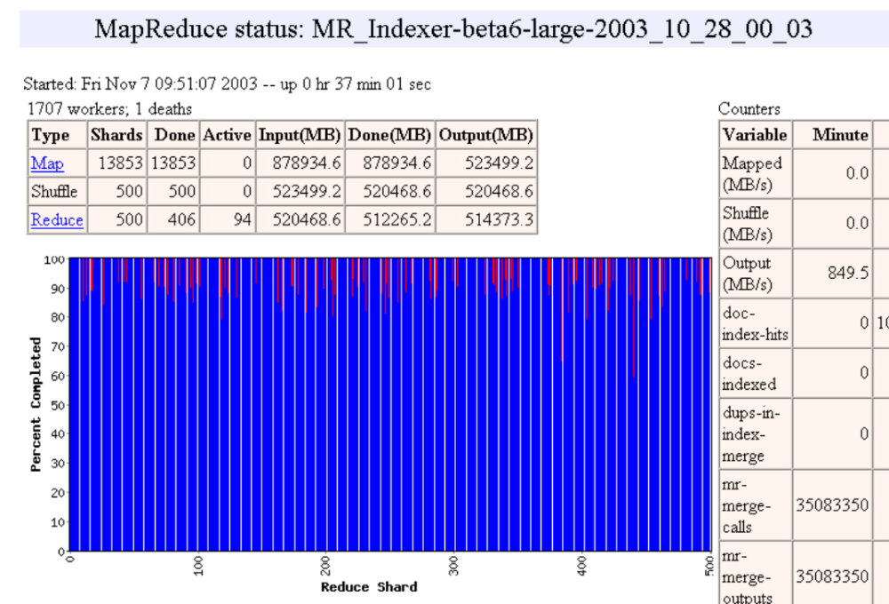
Status monitor

Slide 22
Refinements
Task Granularity
  Minimizes time for fault recovery
  load balancing
Local execution for debugging/testing
Compression of intermediate data

Slide 23
Points need to be emphasized
No reduce can begin until map is complete
Master must communicate locations of intermediate files
Tasks scheduled based on location of data
If map worker fails any time before reduce finishes, task must be completely rerun
MapReduce library does most of the hard work for us!

Slide 24
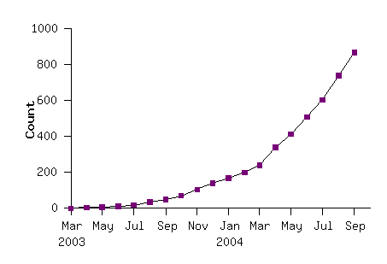
Model is Widely Applicable
MapReduce Programs In Google Source Tree
Examples as follows
distributed grep |  | distributed sort |  | web link-graph reversal
term-vector / host |  | web access log stats |  | inverted index construction
document clustering |  | machine learning |  | statistical machine translation
... |  | ... |  | ...

Slide 25
How to use it
User to do list:
  indicate:
    Input/output files
    M: number of map tasks
    R: number of reduce tasks
    W: number of machines
  Write map and reduce functions
  Submit the job

Slide 26
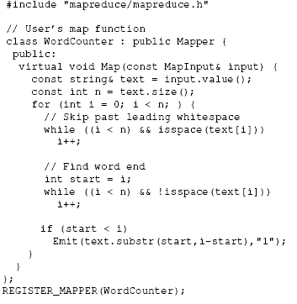
Detailed Example: Word Count(1)
Map

Slide 27
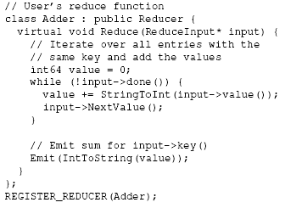
Detailed Example: Word Count(2)
Reduce

Slide 28
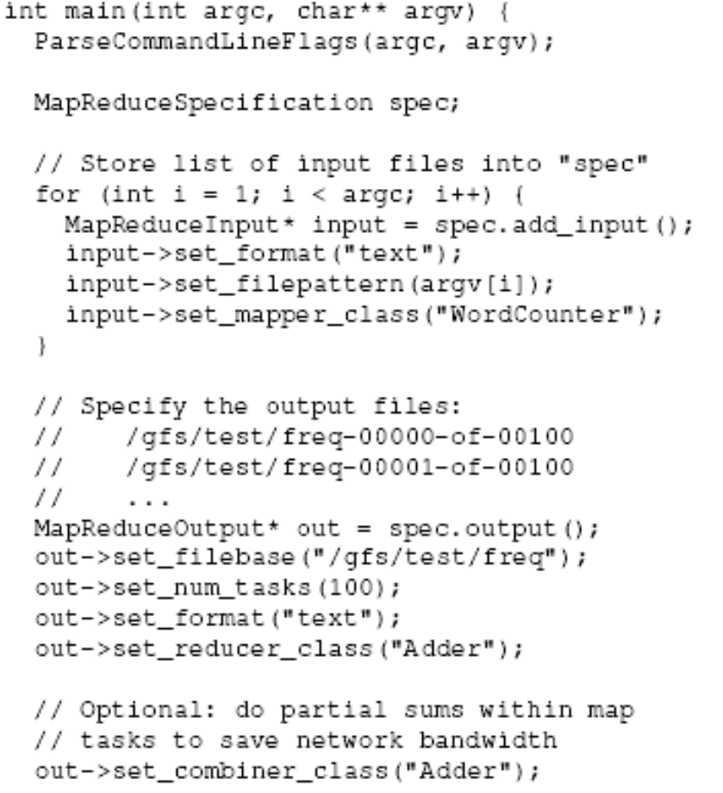
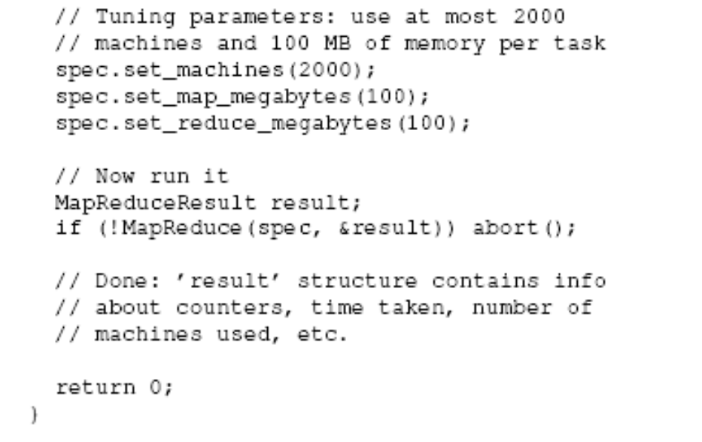
Detailed Example: Word Count(3)
Main

Slide 29
Applications
String Match, such as Grep
Reverse index
Count URL access frequency
Lots of examples in data mining

Slide 30

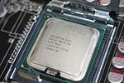
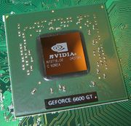
MapReduce Implementations
MapReduce
Cluster,
1, Google
2, Apache Hadoop
Multicore CPU,
Phoenix @ stanford
GPU,
Mars@HKUST

Slide 31

Hadoop
Open source
Java-based implementation of MapReduce
Use HDFS as underlying file system

Slide 32
Hadoop
Google | Yahoo
MapReduce | Hadoop
GFS | HDFS
Bigtable | HBase
Chubby | (nothing yet… but planned)

Slide 33
Recent news about Hadoop
Apache Hadoop Wins Terabyte Sort Benchmark
The sort used 1800 maps and 1800 reduces and allocated enough memory to buffers to hold the intermediate data in memory.

Slide 34
Phoenix
The best paper at HPCA’07
MapReduce for multiprocessor systems
Shared-memory implementation of MapReduce
  SMP, Multi-core
Features
  Uses thread instead of cluster nodes for parallelism
  Communicate through shared memory instead of network messages
  Dynamic scheduling, locality management, fault recovery

Slide 35
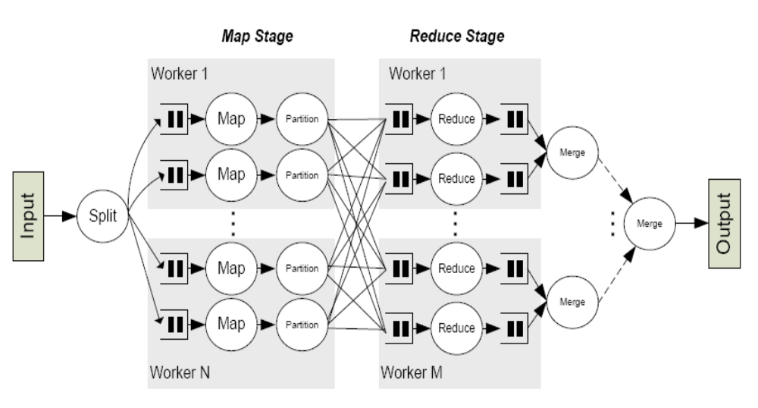
Workflow

Slide 36
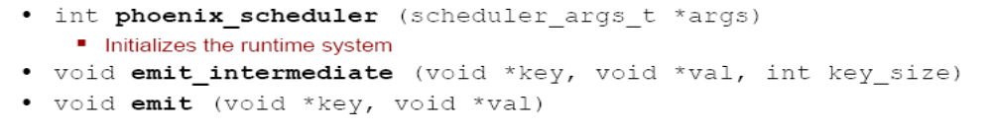
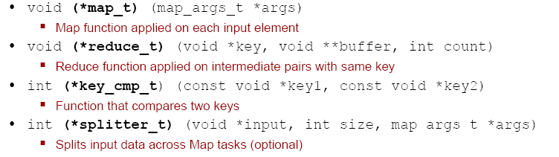
The Phoenix API
System-defined functions
User-defined functions

Slide 37
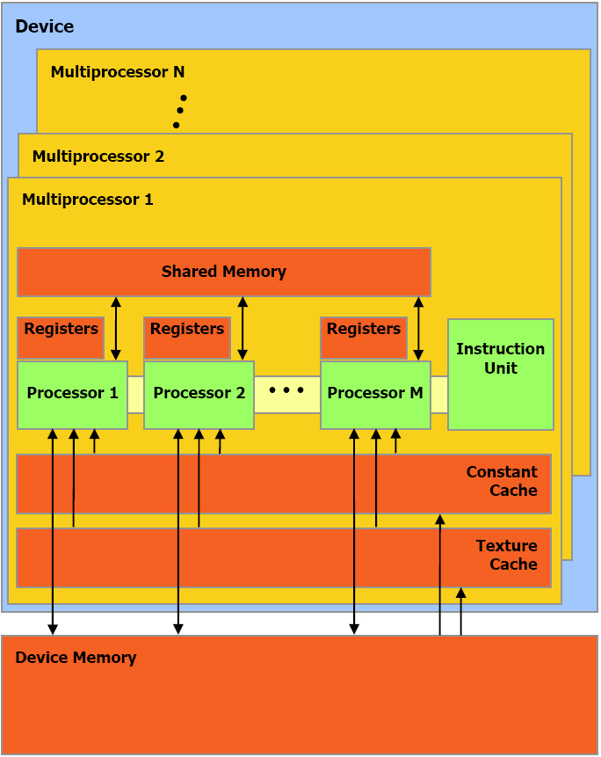

Mars: MapReduce on GPU
PACT’08
GeForce 8800 GTX, PS3, Xbox360

Slide 38
Implementation of Mars
User applications.
MapReduce
CUDA
System calls
Operating System (Windows or Linux)
NVIDIA GPU (GeForce 8800 GTX)
CPU (Intel P4 four cores, 2.4GHz)

Slide 39
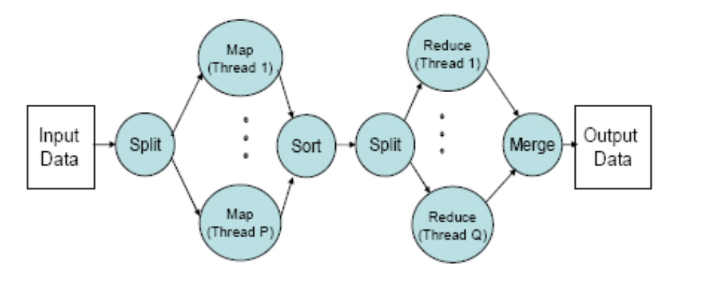
Implementation of Mars

Slide 40
Discussion
We have MPI and PVM,Why do we need MapReduce?
 | MPI, PVM | MapReduce
Objective | General distributed programming model | Large-scale data processing
Availability | Weaker, harder | better
Data Locality | MPI-IO | GFS
Usability | Difficult to learn | easier

Slide 41
Conclusions
Provide a general-purpose model to simplify large-scale computation
Allow users to focus on the problem without worrying about details

Slide 42
References
Original paper (http://labs.google.com/papers/mapreduce.html)
On wikipedia (http://en.wikipedia.org/wiki/MapReduce)
Hadoop – MapReduce in Java (http://lucene.apache.org/hadoop/)
http://code.google.com/edu/parallel/mapreduce-tutorial.html

